Slide 1
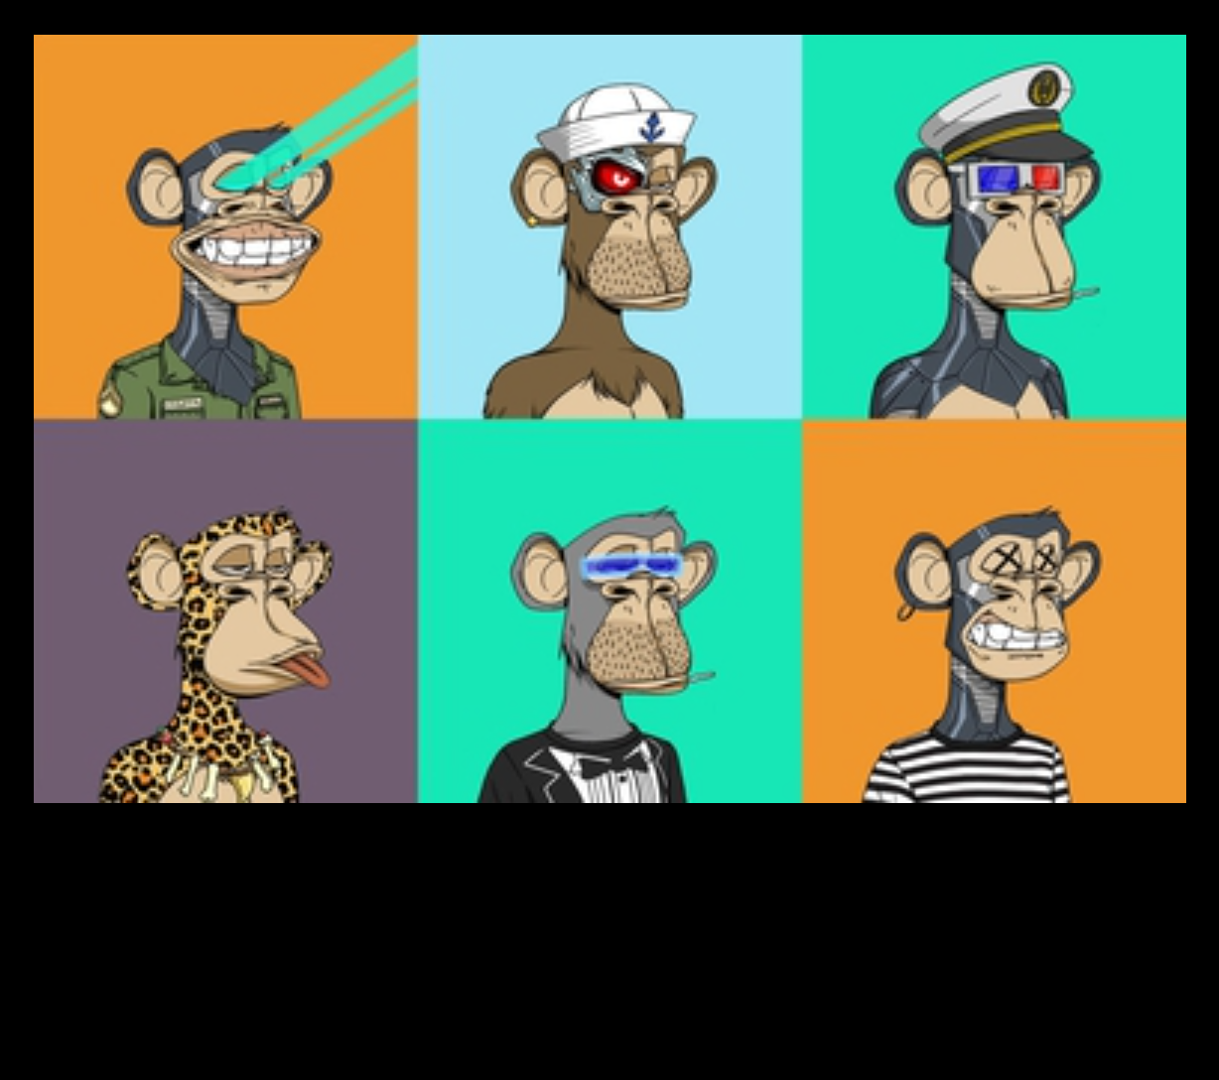
NFT = No Fools Think
A Wise Monkey knows that a fool and his money are soon parted

